Slide 1



Health System Solution
A Comprehensive Client and Program Management System
Presented By: Angera Silas

Slide 2
Approach

Slide 3
Goal
Featres
Provide a solution for managing health programs and clients.
Create health programs.
Register new clients.
Enroll clients in programs.
Search for clients.
View client profiles.
Expose client profiles via APIs.
View program details
View enrollments

Slide 4
Design

Slide 5
System Architecture
Frontend:
Flutter
Cross-platform support (Web, Mobile, Desktop).
Backend:
Spring Boot
RESTful APIs for client and program management.
Database:
PostgreSQL
Stores client and program data.
Integration:
Exposes APIs for external systems.
The system is divided into 3 major parts thats database, frontend and backend.

Slide 6
Health Information System
Frontend
Backend (Java - Spring Boot)
Restful APIs
Database
Flutter & Dart
Docker
PostgreSQL

Slide 7
Workflow Overview
Step-by-step process:
Doctor Registers to the system
Doctor logs into the system.
Doctor creates a health programs.
Doctor registers a new client.
Doctor enrolls the client in one or more programs.
Doctor searches for a client and views their profile.
Doctor views Individual Programs and enrollments made on them.
External systems retrieve client profiles via APIs.

Slide 8
Solution

Slide 9
Key Features & Prototype Demonstration
My solution directly addresses client and program management needs through intuitive UIs and secure APIs.

Slide 10
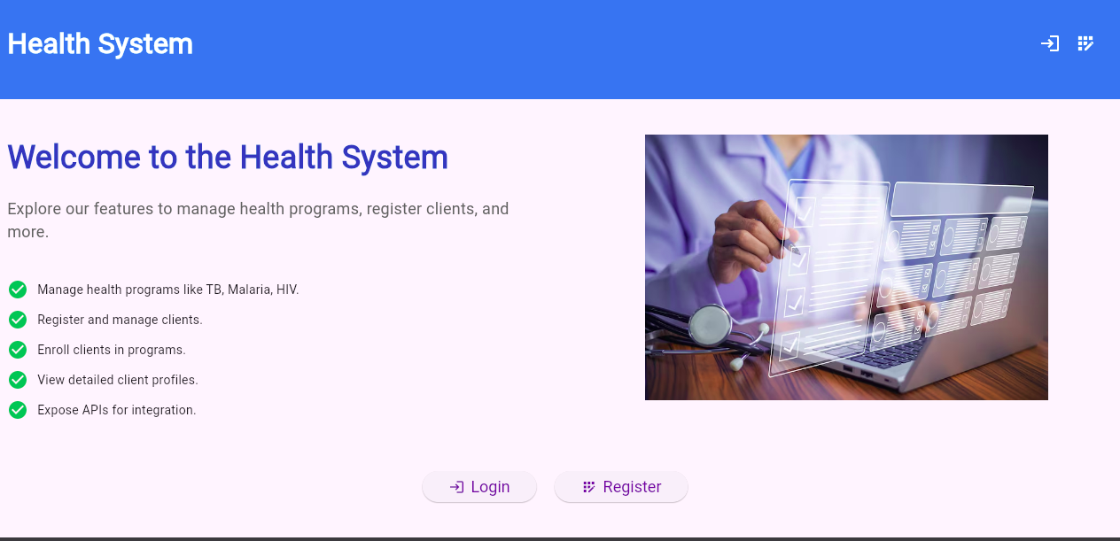

Welcoming Page
Click Login if you already have an account.
Click Register to Create a New account.
Angera Silas Tip | Use this as a guide..

Slide 11
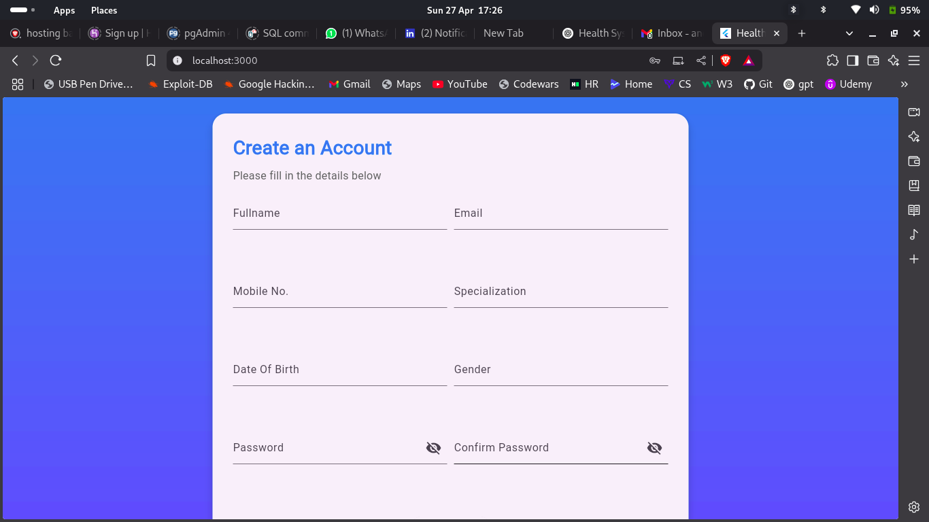
Registration Page
Doctor Registration
Enter Details and Submit to complete the Registration Process
Angera Silas Tip | Use this as a guide..

Slide 12
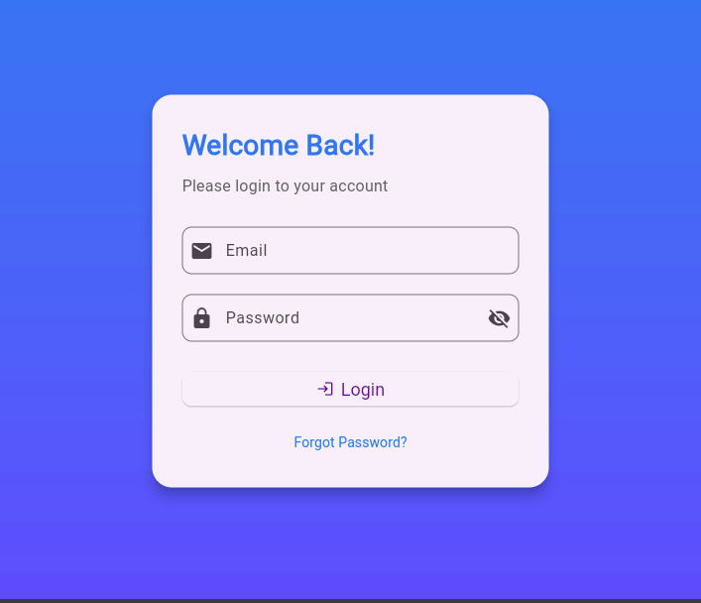
Login Page
Login Page
Enter Details and Submit to access the DashBoard
Angera Silas Tip | Use this as a guide..

Slide 13
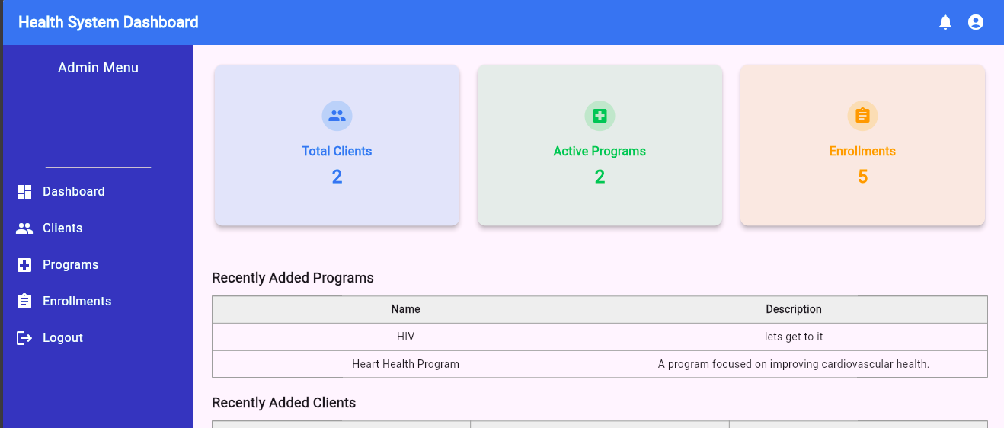
Home Dashboard
The cards shows summaries data from the database
Click the menu options to navigate
The tables shows recently added programs and clients
Angera Silas Tip | Home dashboard is the main page of this system where the user navigates through to other pages

Slide 14
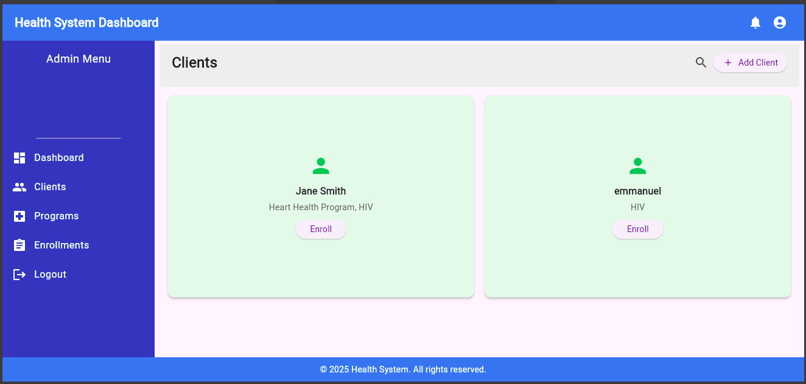
Manage Clients
Manage Clients
Click the search icon to search for specific client details
Click the Add Client button to Register a new client .
Click this card to view clients profile.
Click Enroll button to enrol a specific client to programs.
Angera Silas Tip | Use this as a guide..

Slide 15
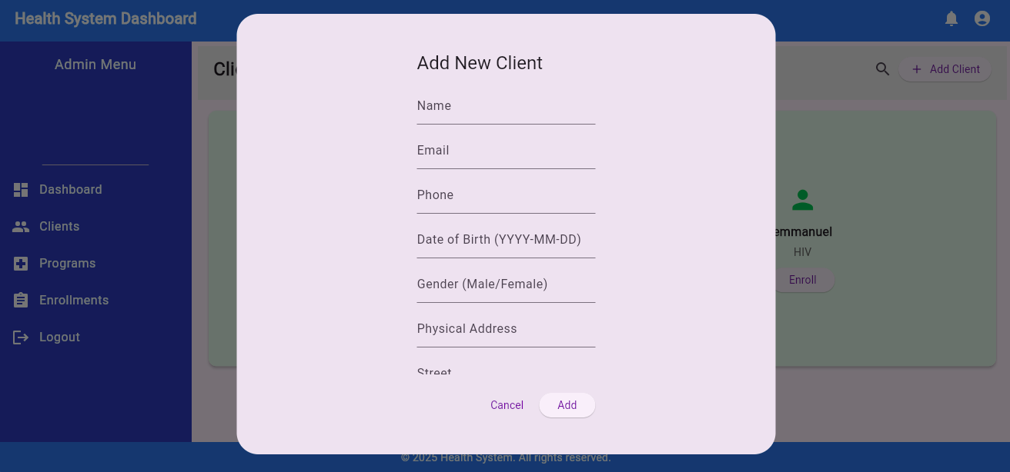
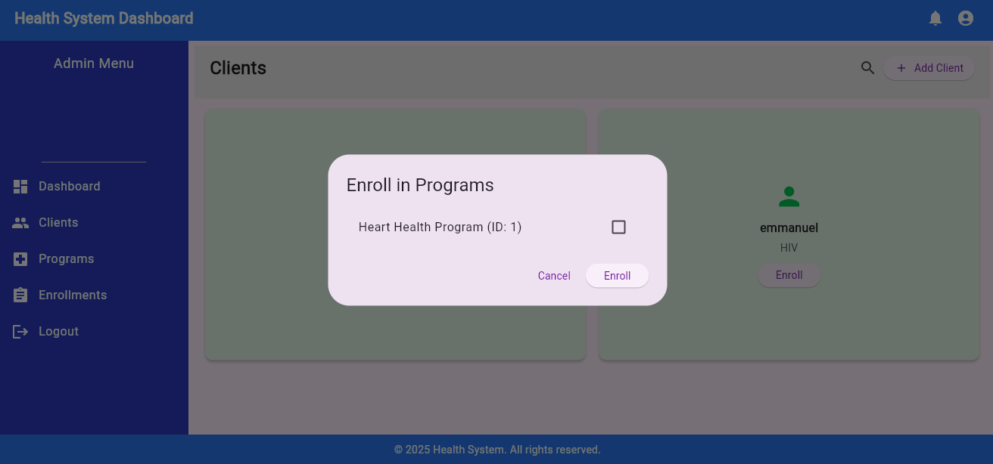
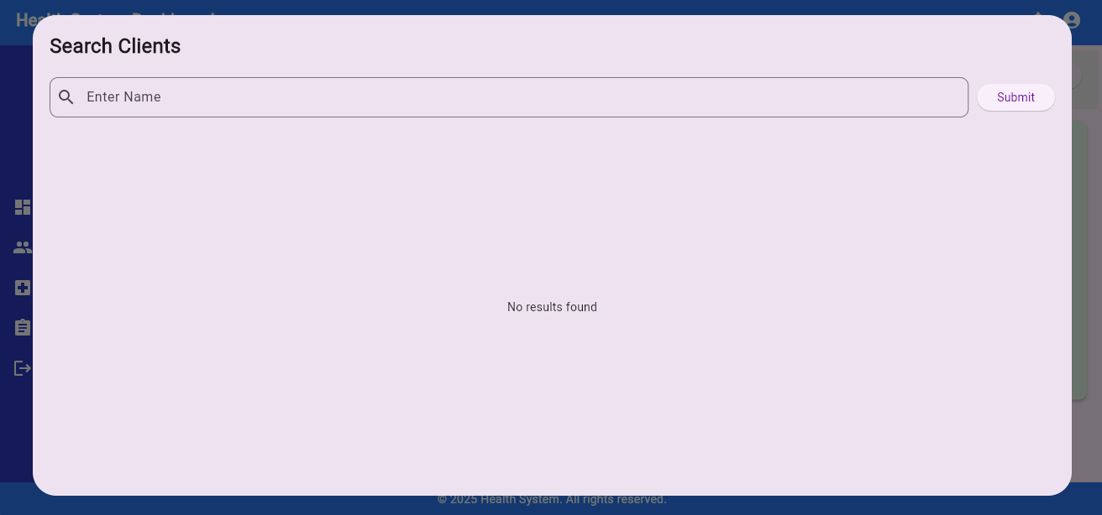
Manage Clients
Manage Clients
Select the programs and enroll a specific client.
After clicking the add client button this form will popup for you to fill and add a new client to the system
Search for a specific client using this form.
Angera Silas Tip | Use this as a guide..

Slide 16
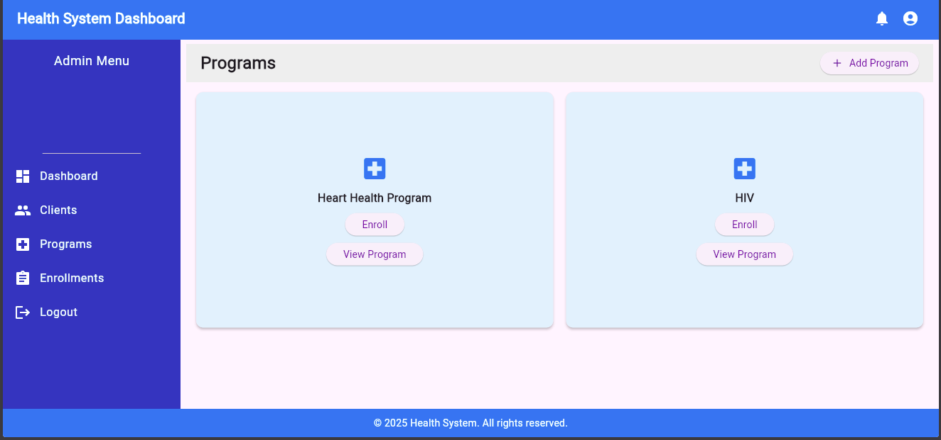
Manage Programs
Click the add program Button to add new Program
Manage Programs
Click the enroll button to enroll clients to a specific program
Click View Program to view details for a specific program.
Angera Silas Tip | Use this as a guide..

Slide 17
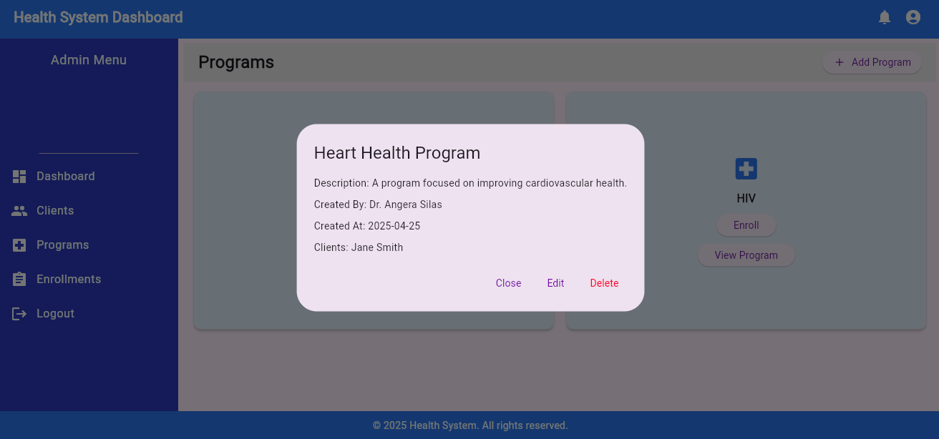
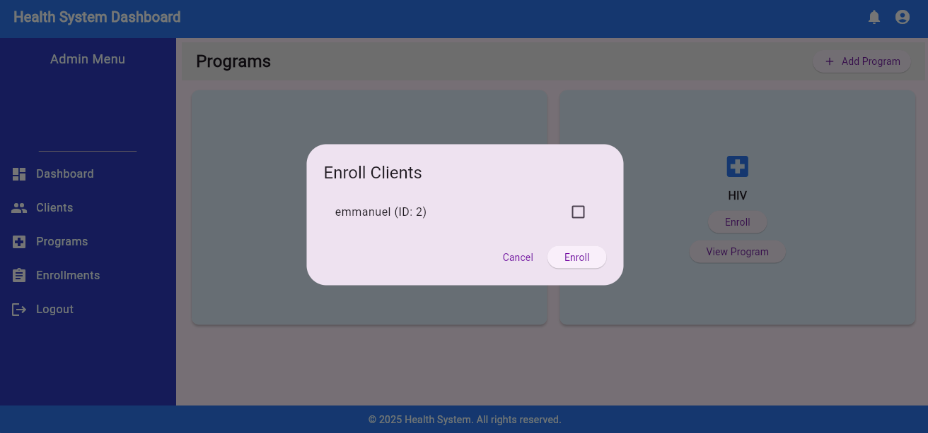
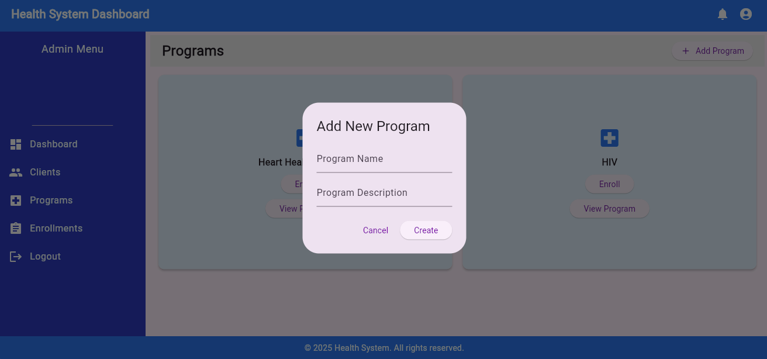
Manage Programs
Manage Programs
Program Details
A form used to enroll clients to a specific program
A form used to add new programs to the system
Angera Silas Tip | Use this as a guide..

Slide 18
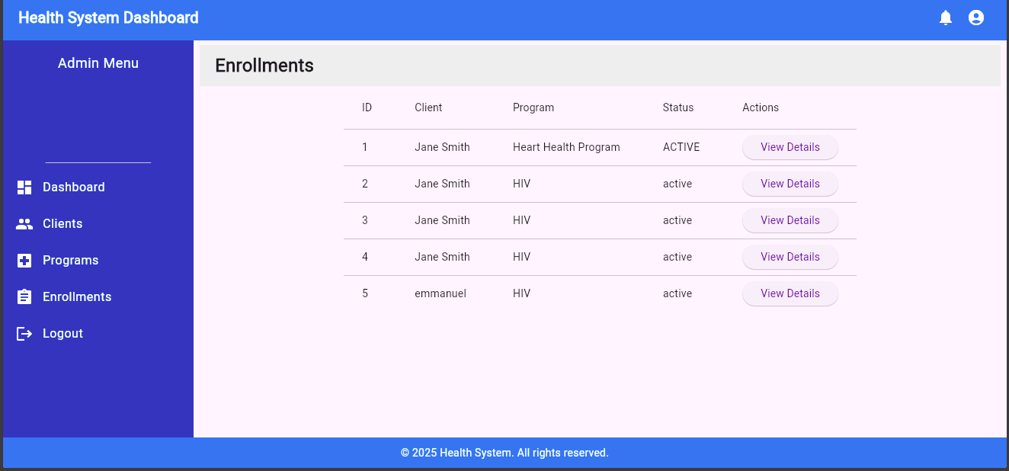
Enrollments
View Enrollments
Click view details button to get more information about a client enrollment.
Angera Silas Tip | Use this as a guide..

Slide 19
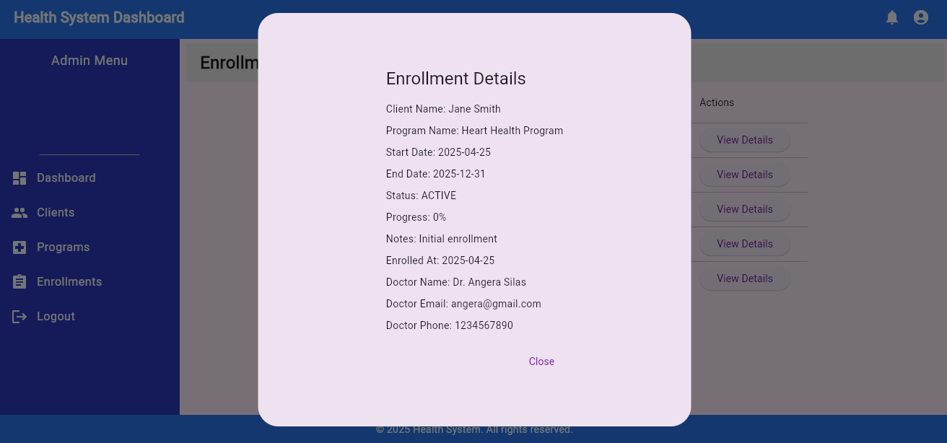
Enrollments
View Enrollments
Details about a specific enrollment.
Angera Silas Tip | Use this as a guide..

Slide 20
API Design
Some of the Endpoints Include:
POST /api/programs/create
POST /api/client-details/create
POST /api/enrollments/create
GET /api/client-details/by-name/{name}
GET /api/client-details/full-info/{clientId}
To get details of clients publicly use /api/client-details/full-info

Slide 21
Thank you!.

